Slide 1
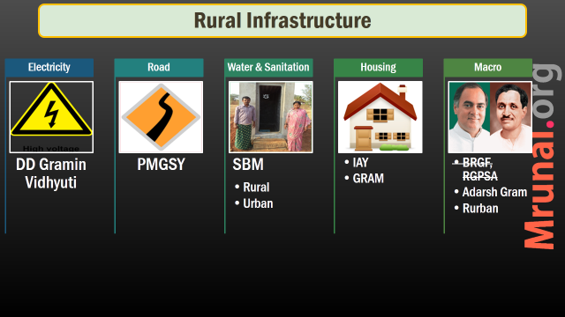
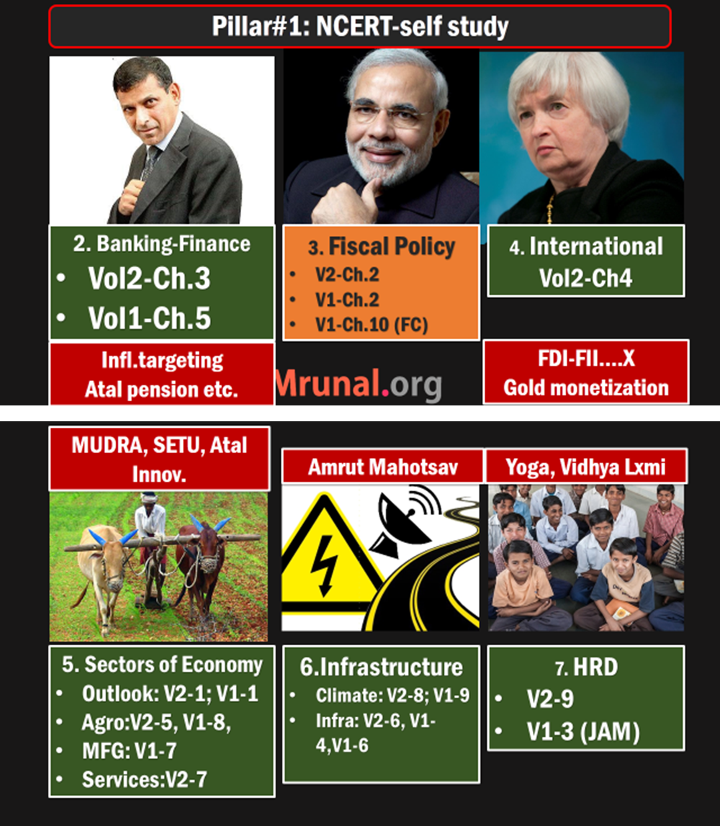



Slide 2
Urban Infrastructure
Housing
2 Bills
Amrut
Smart Cities
Tourism
Sardar Scheme
JNNRUM
What, Why
Pillars
Finance
Criticism
Prasad
Hriday
RAY, RINN
Benchmarks

Slide 3
Census 2011: town types
Statutory
Census Town
Min. 5k Pop AND
Min. 400 Persons / sqkm. AND
75% male in Non-agro.
If muni, cantonment board or Notified town area Committee
4041 towns
3894 towns
Notes:
Number not important but interpretation is: majority of Urban India is “Statutory towns”.

Slide 4
Census definition of city: Depends on population size
MetroP.
10L &+
Urban
T1: 1L &>
Semi-urban
T3: 20k-49,999
Rural
T2:50k-99,999
T4: 10k-19,999
T5: 5k-9999
T6: <5k
Notes:
white label ATM, Rural Branch

Slide 5

Housing problems
Urban infra.
Shortage of ~2 crore houses in urban areas
Compared to China, Thailand, Malaysia- less loans available to EWS, LIG
World Bank 2015- Ease of doing: 184/189 in construction permits- 27 clearances required (14 n S.Asia, 12 in OECD)
Notes:
Economically weaker section and Low income groups

Slide 6
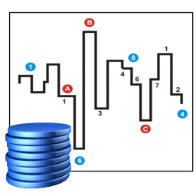
Inflation in housing
RESIDEX
National Housing Bank’s RESIDEX index
residential prices ▲ in most cities.
Highest in Chennai and A'bad
Prices Fell in Meerut and Chandigarh.

Slide 7
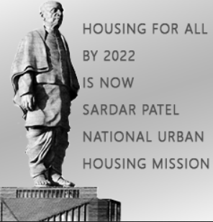
Sardar Urban Housing
housing
2022: 75th anniversary of independence (diamond jubilee)
Housing for all (Amrut Mahotsav)
Oct 2014: Sardar patel urban housing mission
Rajiv Awas Yojana discontinued- meant for slum rehabilitation in two phases.
Rajiv Rinn Yojana discontinued- meant for interest subsidy for EWS/LIG

Slide 8
Sardar Urban Housing
housing
(MoUD): Ministry of Urban Development….No
(MHUPA): Ministry of housing and urban poverty alleviation ….yes.
Interest subsidy, PPP, tax benefits on home loans.
Feb 2015: thinking of renaming it.
Notes:
V.Naidu in both

Slide 9
Urban Housing: Legal reforms
Draft Tenancy Act 2015
Real estate Development bill 2015

Slide 10

Why reform?
Urban Tenancy
Most States follow Rent control Act 1948
Not revised to keep vote bank happy.
Max. rent ceiling very low. Subleting @higher price
Difficult to evict tenant, owner not renovating building = collapse.
2015: Union drafted “Model tenancy act”

Slide 11

Tenancy Act
Before
After
Tenant refuses to pay higher rent- eviction difficult, lengthy court process.
Notice 3 months before old agreement expires. If not accepted- automatic eviction

Slide 12

Tenancy Act
Before
After
Tenancy law applied if agreements with min. 12 months period.
No such term limit.
Deliberately 11 months agreements signed to evade law.
Even 3-4 months renting out possible
Eviction on rent default.

Slide 13

Tenancy Act
Before
After
No such provision
Owner has to refund Security deposit within 1 month of agreement expiry

Slide 14

Tenancy Act
Before
After
No such provision = nuisance of bogus stamp paper agreements
State appointed rent authority for agreement registration => rent court in HC
Hear disputes.

Slide 15


Tenancy Act
Before
After
No such provision = harassment by land owner
Landlord can enter only in 7AM to 8PM, that too after serving 24 hours notice.

Slide 16
Urban Housing: Legal reforms
Draft Tenancy Act 2015
Real estate Development bill 2015

Slide 17

Real estate regulation bill 2013
housing
“Contracts”: concurrent list, parliament can legislate.
State real estate regulatory authority (RERA) =>State real estate appellate tribunals
Builder to register project @RERA, only then he can begin selling. – layout plan, names of architect, engineers.

Slide 18
Real estate regulation bill 2013
housing
Plan alteration need approvals from 2/3rd of buyers
Structural defects, deadline miss= refund $$
Broker mis-selling = penalty
Gone to Rajya Sabha’s select Committee.

Slide 19
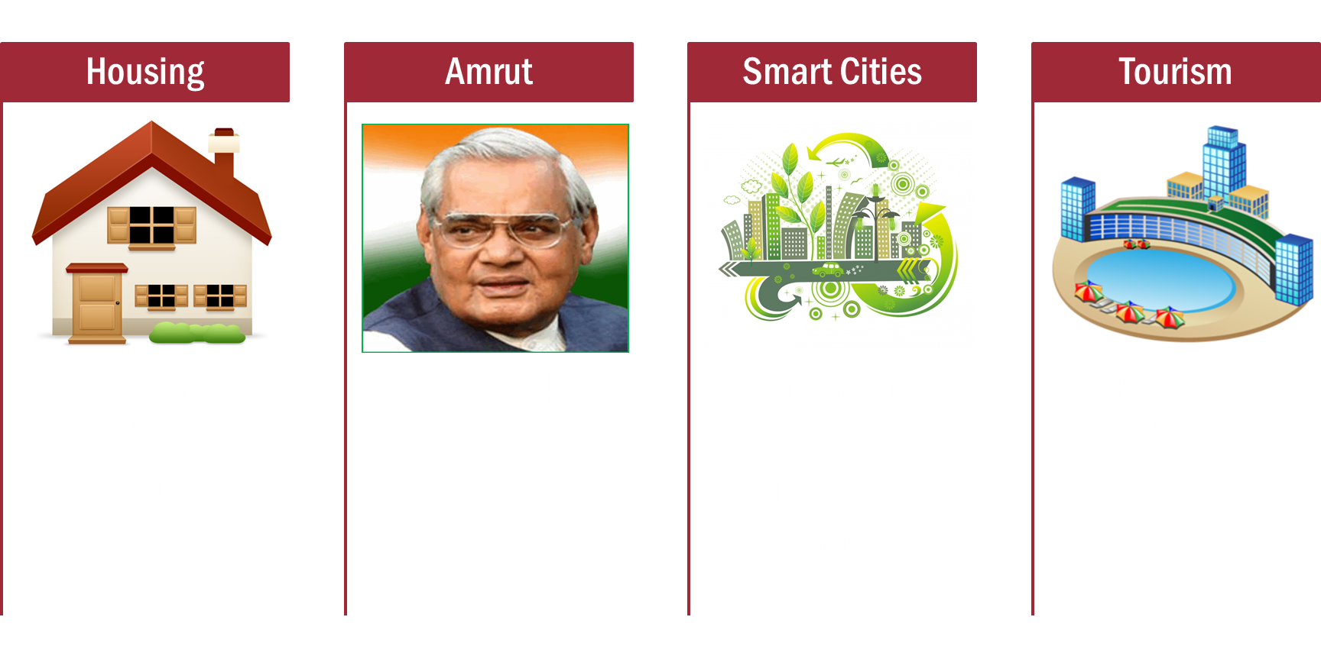
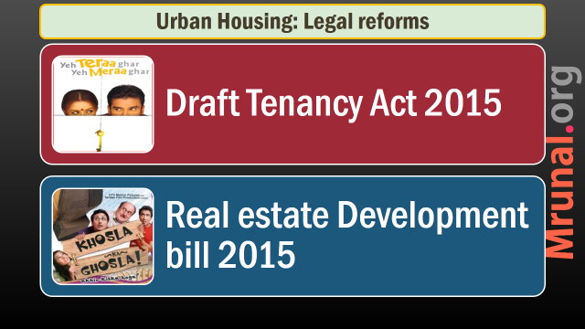

Slide 20
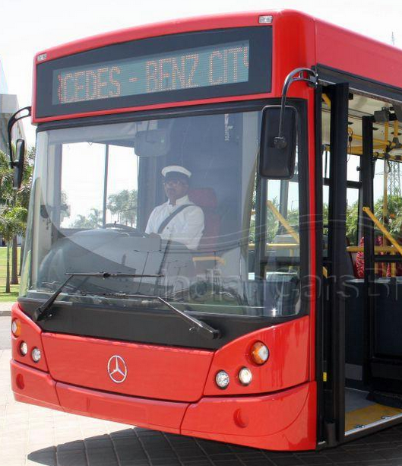
JNNRUM 2005
Urban Infra
Jawaharlal Nehru National Urban Renewal Mission (JNNURM)
Ministry of Urban Development
Sub missions: water supply, sanitation, transport, waste Management
2015: AMRUT to replace JNNURM. But If JNNURM project 50% finished then AMRUT will finance it as well

Slide 21
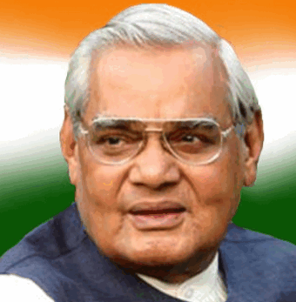
AMRUT
Urban Infra
Atal Mission for Rejuvenation and Urban Transformation (AMRUT)
Under urban Development ministry
500 cities w/ 1 lakh+population
10 years plan x Rs.2 lakh crores
Water supply, waste collection, recycled water for organic farming, wifi-zones, mass transport etc.
Union will not appraise each project. It’s left States=> Cooperative Federalism

Slide 22
Urban Infrastructure
Housing
2 Bills
Amrut
Smart Cities
Tourism
Sardar Scheme
JNNRUM
What, Why
Benchmark
Finance
Criticism
Prasad
Hriday
RAY, RINN
Pillars

Slide 23

Smart Cities
Urban Infra
What & Why?
Benchmark & Pillars
$$ Finance
Criticism

Slide 24

WHY?
Smart city
2008: 34 cr people | 60% GDP
2030: 59 cr people | 75% GDP
Cities= engines of economic growth
Demand for every civic amnestic to rise by 5-7 times, esp. by neo middle class
New Satellite town, mid sized cities required to accommodate migration

Slide 25
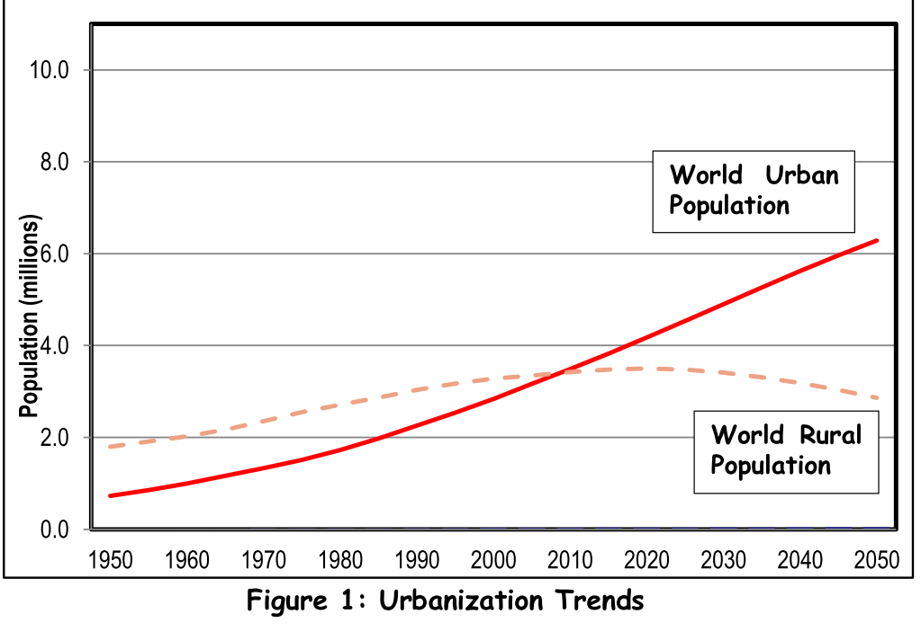

Slide 26
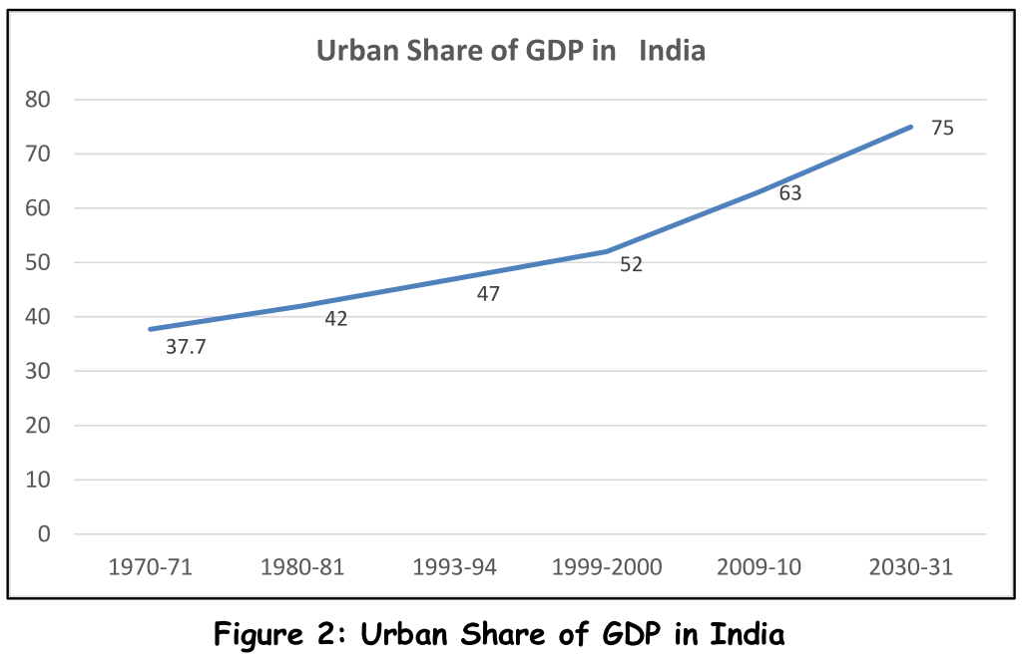

Slide 27

Economic Problems Mains-GS1
Urbanization
Migrant inflow=> Informal employment, exploitation (factory-labour reforms GS2)
Under-employment=>crime, drug abuse, alcoholism. (Skill India, Nirbhaya-CCTV, Police-reforms)
High land prices=> black money (Tax-adm-reforms;new bills GS3)
Muni. Insufficient funds=> poor civic amnesties (PPP, Smart cities, REITS, INVITs GS3)

Slide 28

Environment Problems Mains-GS1
Urbanization
High rent=>living peripheral area=> pub.transport=>pollution (metros, BRTS, Bharat Emission Norms, A.Q.I.,)
Energy crisis, diesel generator in malls (net metering, rooftop solar plants, nuke plants, )
Slums=>Sewage=>diseases=>poverty [Swatchh bharat Mission]
Pesticides, glass buildings=>sparrow decline
Notes:
Delhi no petrol without PUC
Delhi higher tax on second vehicle.

Slide 29
Definition: What is Smart city?
Smart infra
Physical
Smart “-y”
Utility
Technology
VIA some %
Social / civic
Economic
Mobility
100% ICT but not “end”
0% Bureaucratic hassles

Slide 30
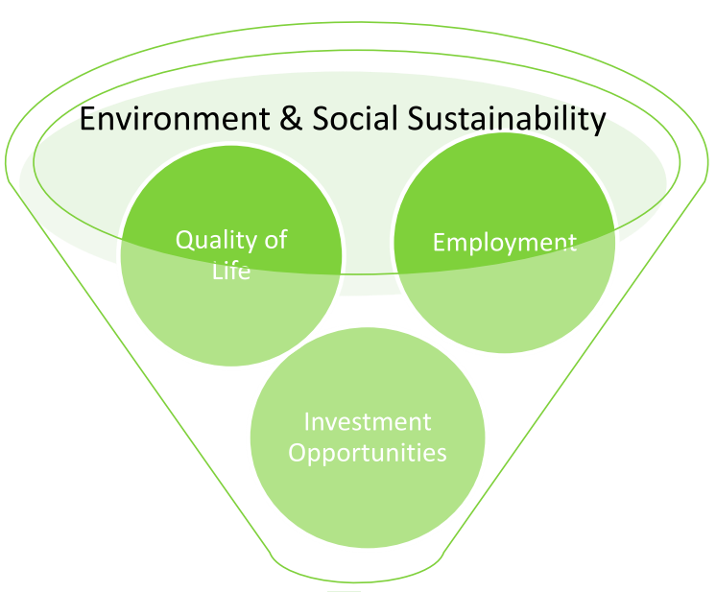
What is smart city?

Slide 31
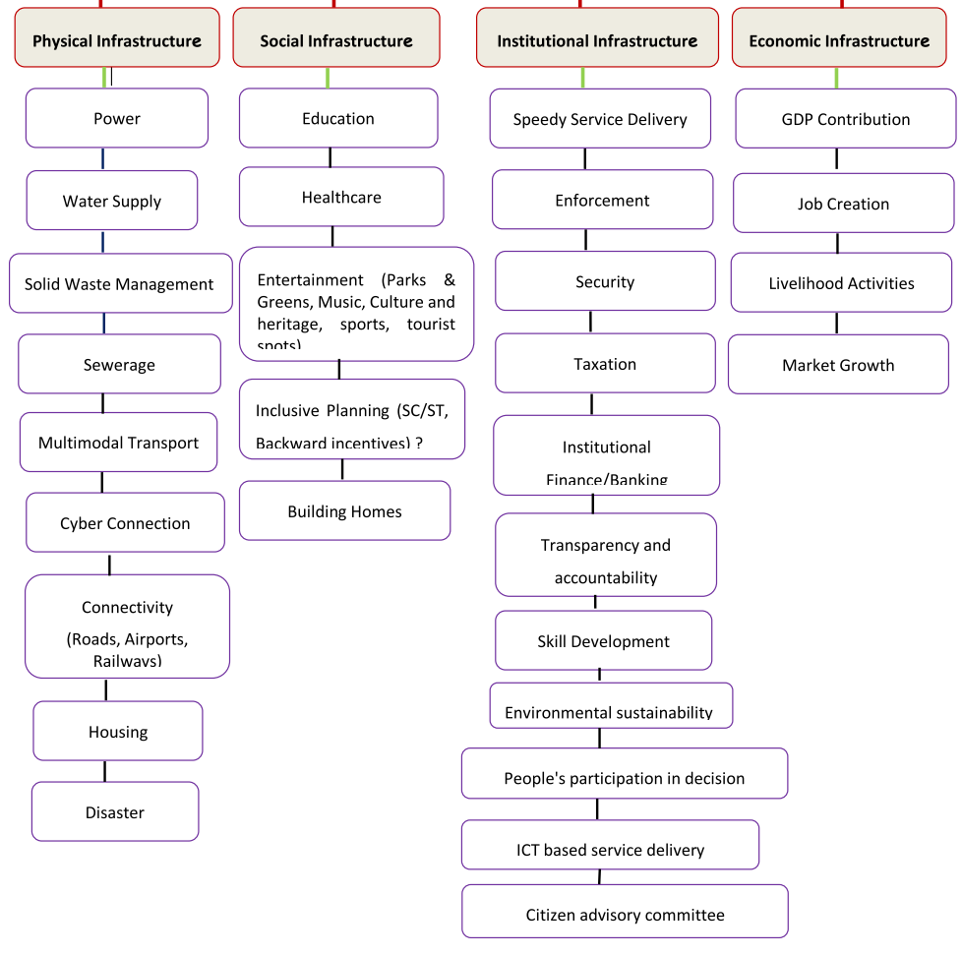
Smart city infrastructure

Slide 32
Some examples
Smart City
Boston: Gunshot sensor
Iowa: smart water meter, can compare with neighbor’s usage
Dublin (Ireland): IBM’s “ParkYa” app for finding parking slot
London: Mayor gets constant data analysis of twitter feeds
Surat: online monitoring of water quality

Slide 33
Smart Cities
Urban Infra
What & Why?
Benchmark & Pillars
$$ Finance
Criticism

Slide 34
Smart city: Benchmark, Pillars
Communication
Economic
Housing
Electricity
Education
Healthcare
Water
Transport

Slide 35
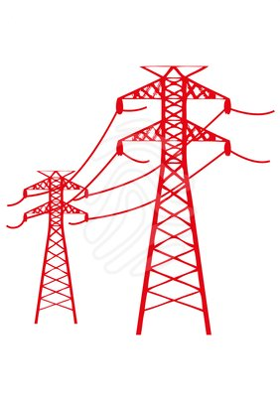
Smart city: Electricity infrastructure
Smart grids
Self-healing against power outages
Resilient against cyber-attacks
Renewable Energy
10% requirement through RE
Rooftop Solarcells, Grid connectivity
Digitally managed street lights

Slide 36
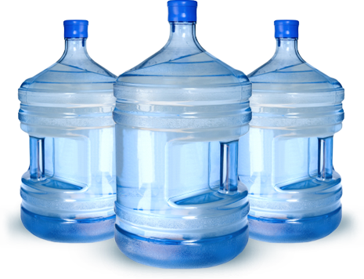
Pillar Water, Sanitation
Smart city
Swatch Bharat Mission: L7/P4.pptx
Rainwater harvesting, Stormwater drainage
Segregation: recyclable and no recyclable. Smart transport- optimal route via ICT, Treatment / disposal.
Penalty for civic indiscipline: (1) slum encroachment (2) littering (3) misuse of water, electricity etc.
Notes:
by deranged youth of Paris

Slide 37
Smart city transport
Public
BRTS
Road
ring roads
Lanes
bypasses
underpasses
elevated roads
Waterways
Cycling: Velib-Paris
walking
Metro
Monorail
TRAM
Mass transport within 10-15 minutes walk
▼GHG, Traffic Jam || Men-material transport ▲
Notes:
Bibek Debroy rail restructuring

Slide 38
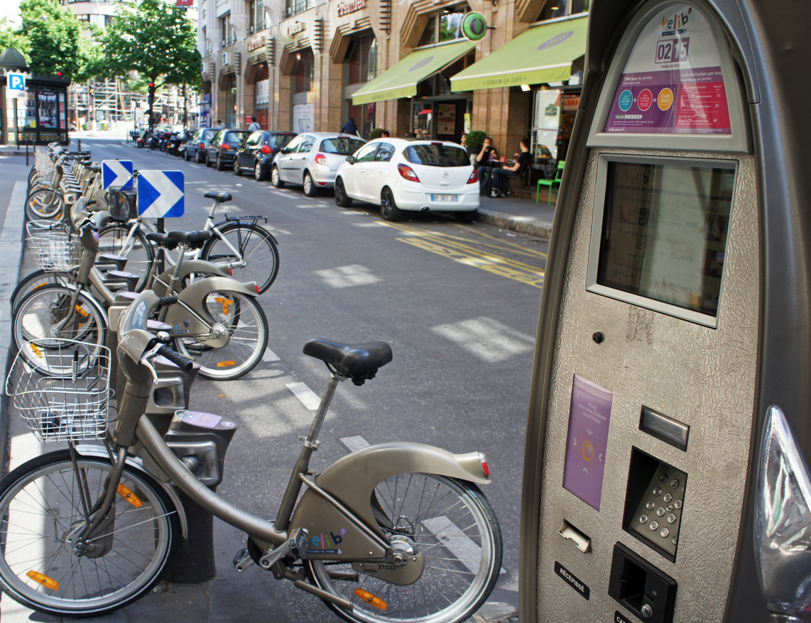
Paris: Velib – public bicycle sharing system

Slide 39
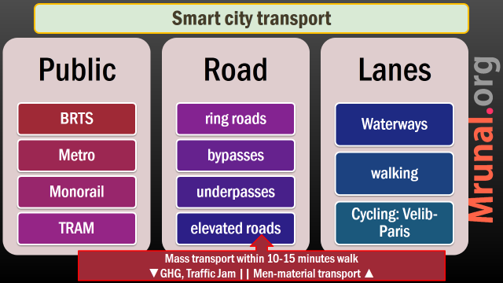
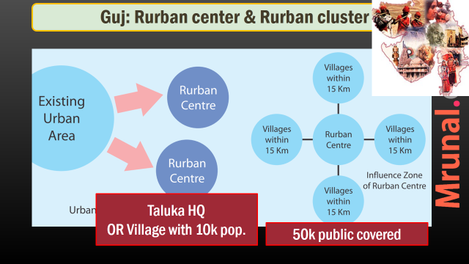
positive impact on Rural GDP via RURBAN
Notes:
% wise 75, but absolute will increase

Slide 40

Smart city: Benchmark, Pillars
Communication
Economic
Housing
Electricity
Education
Healthcare
Water
Transport

Slide 41

Benchmark housing
Smart city
20% houses occupied by poor (EWS, LIC)
Sardar Patel National Housing Mission
95% houses have school, shopping and parks within 400m, all integrated with ICT.

Slide 42
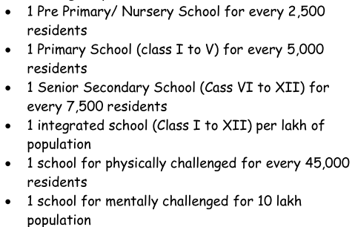
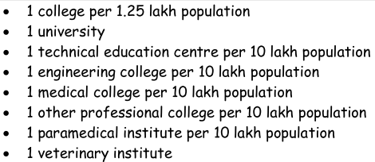

Smart city: education infrastructure
Nurseries, Schools
Colleges
golf courses, swimming pools, sports complex.

Slide 43
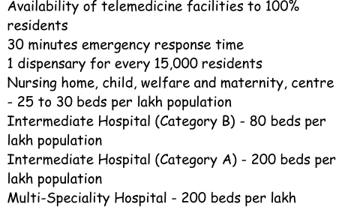
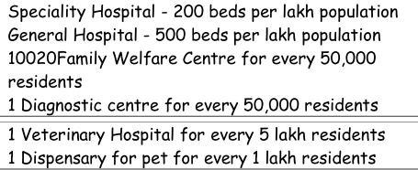

Smart city: medical infrastructure

Slide 44
Smart city: Benchmark, Pillars
Communication
Economic
Housing
Electricity
Education
Healthcare
Water
Transport

Slide 45
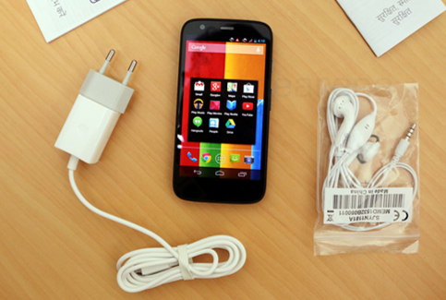
Benchmark Civic utilities
Smart city
24 x 7 water, electricity, emergency, medical service, fire service
Communication: telephone and Wi-Fi to all households @100mbps.

Slide 46
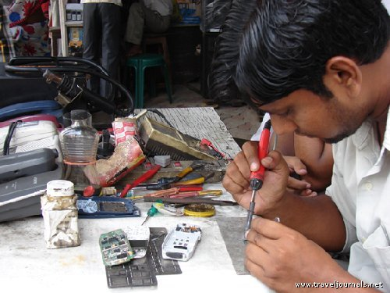
Economic Infrastructure
Smart city
Kiosk banking, mobile banking apps, Rupay cards etc.
Youth: skill development centres (Din Dayal Antyodaya L5/P4.pptx)
Start ups: incubation centres (SETU, ATAL, Mutra L5/P3.pptx)
Financial centres (e.g. GIFT city L6/p3.pptx)
warehousing- freight terminals
Export parks for IT & mfg.
Notes:
Aside, town of export excellence.not just improving quality of life, we’ve to increase investment / employment opportunities as well.

Slide 47
Smart city: Benchmark, Pillars
Communication
Economic
Housing
Electricity
Education
Healthcare
Water
Transport

Slide 48
Smart city selection: 3 documents needed
Citizen reference framework
what do people want? via nukkad meeting, workshop, surveys
Smart city Development plan
GIS, spatial, ICT mapping & financial requirements
Environment sustainability plan
trees, water-waste Management, Disaster management

Slide 49
Selection
Smart city
states to shortlist aspirants
Union to finalize list & give funding
Each state to get min.1 smart city
Total 100 smart cities planned

Slide 50
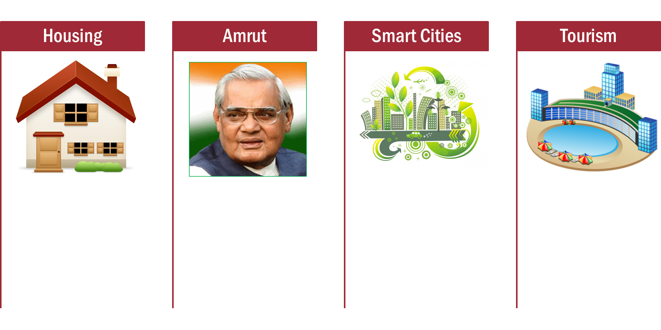

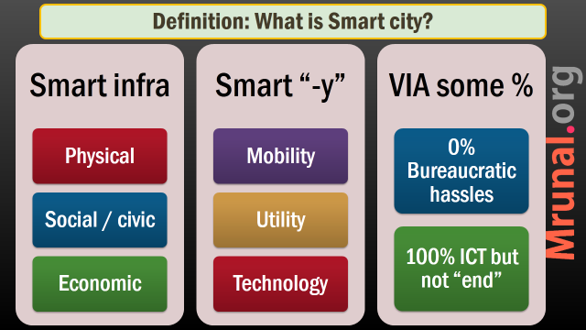
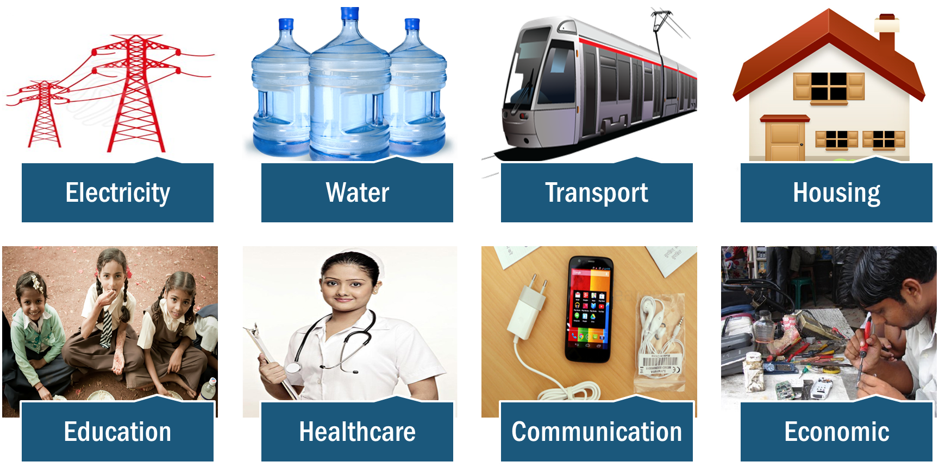

Slide 51
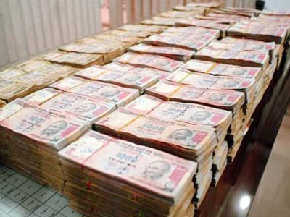
finance
Smart city
May 2015: announced 46k crore for 100 smart cities.
7 lakh crores over 20 years.
Government funding: 60% to infra, 10% to e-Gov.
10% bonus funding on performance.

Slide 52
finance
Smart city
Independent regulators for water- electricity user fees, property taxes (14FC recommended same. L4/P3.pptx)
Use private sector to develop public transport, recover the cost to user fees
REITs, InvITS, tax free municipal bonds.

Slide 53

REITS
finance
REITs: Real estate investment trusts
InvITs: infrastructure investment trusts (airport, highway, thermal plants, gas grid etc.)
Similar to Mutual funds (L2/P1)
Invest in income generating assets
Return to unit holder from rent/user fees.

Slide 54



SEBI norms for REITs
Investors: HNI / institutions. Min. 2 lakh per applicant
Units Sold
Min. 250 crore issue size
Listed @stock exchange
Min. 200 members | 25% public holding
Dividend
Invested $$
REITs portfolio
Fund Manager
SEBI regulates
invest in rent generating asset-commercial, residential property, malls etc.
RENT
Finished / soon to finish real estate project
Notes:
They are investment trusts that operate much like the mutual funds except for the fact that they invest in income generating real estate assets — commercial, residential etc and thereby look to generate return for the investors within the fund.

Slide 55
REITs, INVITS
Benefits
Tried tested in US, UK, Aus., Japan
Stressed developer gets new finance: else NPA (L7/P1.pptx)
Unit can be sold in stock exchange (like CPSE-ETF) : don’t have to wait till maturity (L2/P1.pptx)
New investment opportunity for people=> may be positive real interest rate => gold ▼ => CAD ▼

Slide 56
100% FDI
Smart Cities
*Minimum build up area (sq.m) | 20k
*Investment (USD) | 5 mil.
Lock in period after project completion | 3 years
* Exempt if 30% low cost housing

Slide 58
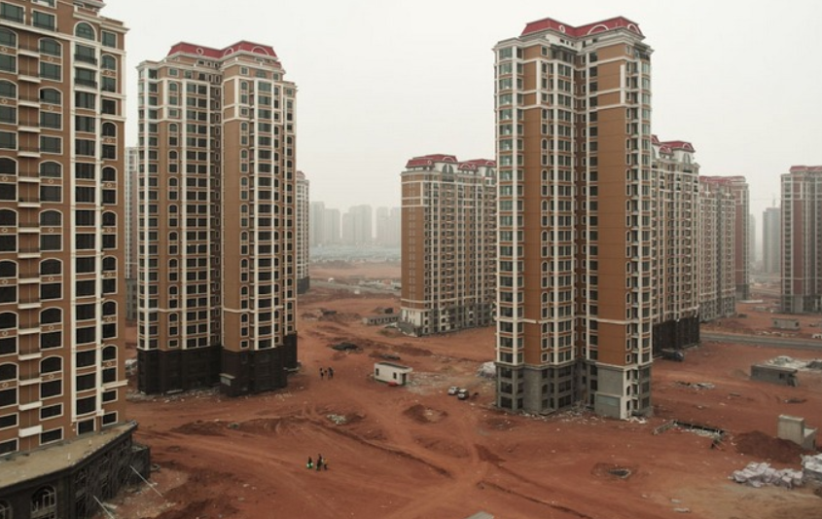
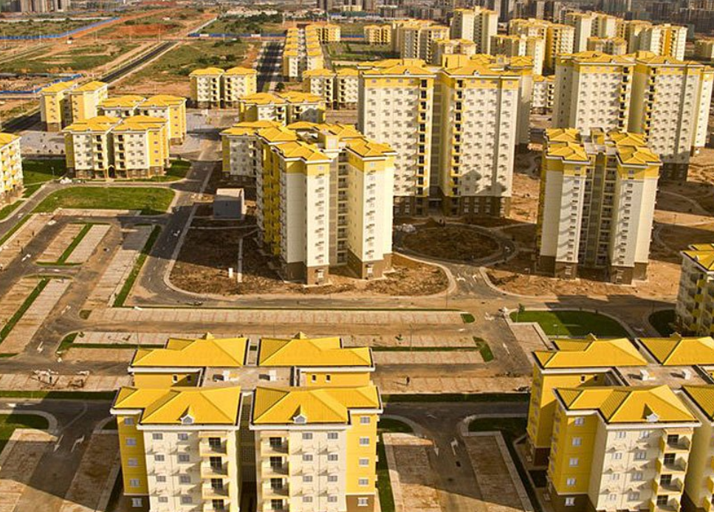
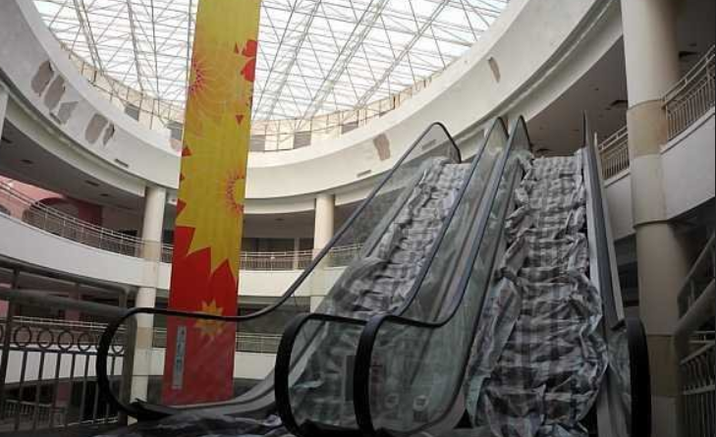
Smart Ghost cities of China

Slide 59
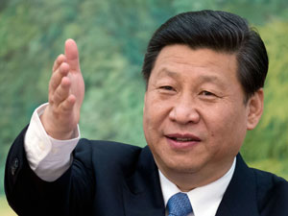
Ghost smart cities
China
Near Guiyang, Wuhan, Nanjing and Hefei & other provincial capitals.
They're building "satellite towns"- Copycat "western" cities: central business district, huge malls, skyscrapers, residential flats.
Too much $$ pumped into metro system to reduce pollution compared to population density in given town.

Slide 60
Ghost smart cities
China
All Land nationalized, leases sold for 70 years.
Middleclass families bought leases, hoping to sublet the apartments for steady income.
But outsiders not settling in- harsh weather, low economic opportunities
Most infamous Ordos city, Inner Mongolia.

Slide 61

Criticism
Smart city
Cyber terrorism or even a Software bug can crash public transport & electricity grid.
CCTV constant surveillance, prone to misuse by authoritarian Government
Smart maps, smart metered connections= advertisement spams.
Notes:
Vastapur- Alpha1 mall, washing machine.

Slide 62
Criticism
Smart city
soulless landscape of glass, steel, and concrete boxes connected through ICT & wires.
"Sense of place" is lost. All streets and shops identical- Songdo, S.Korea
People lose communication, family-community values in smartphone with GPS & wifi
Better focus on rurban first.

Slide 64


Tourism promotion
Prasad
Hriday
Heritage City Development and Augmentation Yojana
Urban Development Min.
Pilgrimage Rejuvenation and Spirituality Augmentation Drive
Tourism Min.
100% CSS
100% CSS

Slide 65
Funding: both 100% CSS
Prasad
Hriday
Funding in installment
Similar
20% @approval
60% $$ when 20% work done
20% $$ when 60% work done
Notes:
Centrally sponsored schemes

Slide 66
Tourism promotion
Prasad
Hriday
Validity: 4 years, starting from December 2014
??
Tripartite agreement with union, state and urban local body
Execution through PWD, PSUs, SPV and NGOs

Slide 67
Tourism promotion
Prasad
Hriday
??
Hunar se Rozgar tak (HSRT) and earn while you learn programs
Vocational training for tourist guides hospitality business

Slide 68

Selected cities
Prasad
Hriday
12 cities shortlisted: Amaravati (Andhra Pradesh), Gaya (Bihar), Dwarka (Gujarat), Amritsar (Punjab), Ajmer (Rajasthan), Kanchipuram (Tamil Nadu), Vellankani (Tamil Nadu), Puri (Odisha), Varanasi (Uttar Pradesh), Mathura (Uttar Pradesh), Kedarnath (Uttarakhand) and Kamakhya (Assam)
12 heritage cities: Amaravati, Gaya, Dwarka, Badami (Karnataka), Puri, Amritsar, Ajmer, Kanchipuram, Vellankani, Warangal (Telangana), Varanasi, and Mathura.

Slide 69

Hriday
Tourist infra
Public transport, water and solid waste management, sanitation.
Street furniture, battery-operated vehicles, smart signs- Digital brochure, kiosks
Cultural events, fairs, festivals
Museum and cultural spaces
Wi-Fi, CCTV cameras
Cottage industry, handloom industry: market haats
Training tour operators, guides, local artisans and women entrepreneurs

Slide 70
Prasad
Tourist infra
ATM, foreign currency exchange counters
Rail, road water transport
Green energy streetlights
Water adventure sports
Emergency vehicle breakdown repair and refueling facilities
First-aid centres, Wi-Fi hotspots, Parking facilities
Green landscaping, water fountains, walkways, furniture etc.
Removing encroachments

Slide 71
Prasad & Hriday: Outcomes?
Employment ▲
Tourist Traffic ▲
Crime, Pollution ▼
Sus.Development ▲
Cleanliness ▲

Slide 72

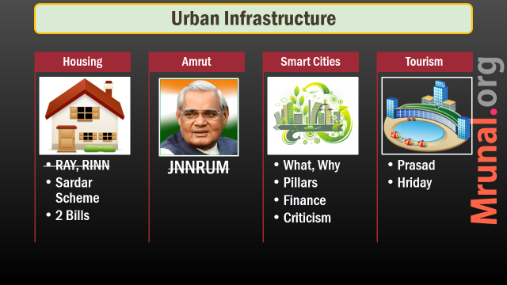
Next time Spectrum, Climate Change

